Slide 1






Machine learning
Cours 4 : Entraînement
David Rousseau

Slide 2
Opening the black boxes
So far we have been using regression and classifier as black boxes.
In this chapter we go beyond and understand how to optimize these systems
We focus on regression for illustration here

Slide 3
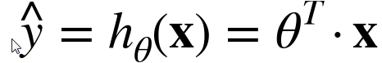
Linear regression
In course 1 we analyze a linear regression
In general linear regression reads
Where
« y hat » is the predicted value of y
n the number of features
xi is the ith feature value
θj is the jth model parameter
This is equivalent to the matrix expression
Where θ is the model’s parameter vector
θT is the transpose of θ
x the instance feature vector

Slide 4
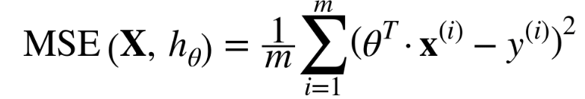
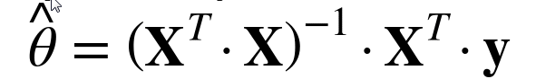
Training
To find the best model we need a performance metric
There is a closed-form analytical expression, called normal equation for the optimum « θ hat »
Where y is the vector target values containing y(1) to y(m)

Slide 5
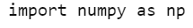
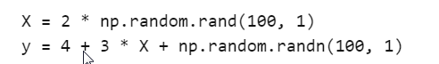
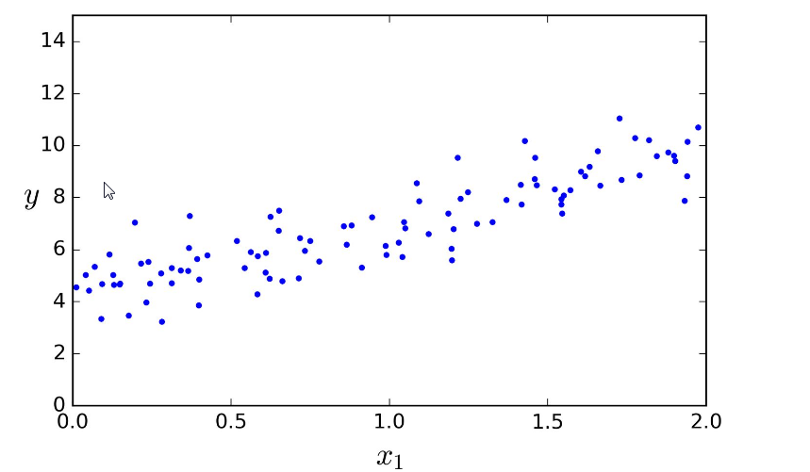
An example

Slide 6
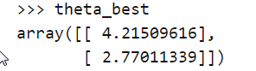
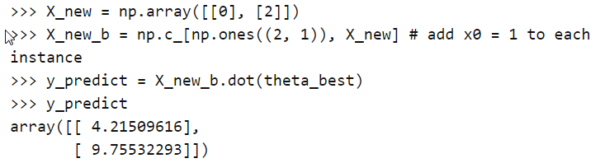
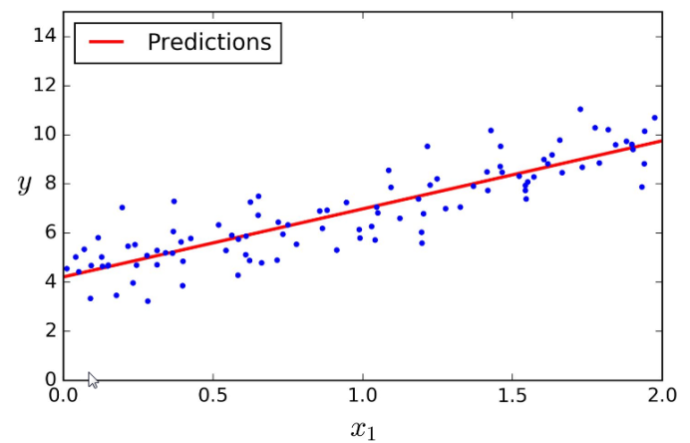
Solution for this example
The numerical solution is
To compare to the exact solution
Now you can make predictions

Slide 7
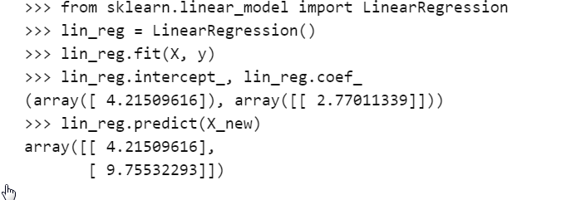
Scikit learn code for this

Slide 8
Computational complexity
The normal equations
Computes the inverse a matrix which can be huge if the amount of features is large
The computational complexity of inverting such a matrix is typically O(n^3)
If you double the number of features by two you increase the computational time by 8

Slide 9
Gradient descent
A very generic optimization algorithm capable of finding optimal solutions to a wide range of problems technique
The idea is to twead parameters iteratibely in order to minimize a cost function
Suppose you are list in the mountain and you want to recover the valley but you can only feel the slope on your feet
A good strategy to get to the bottom of the valley quicly is to go downhill in the direction of the steepest slope
This is exactly what gradient descent does

Slide 10
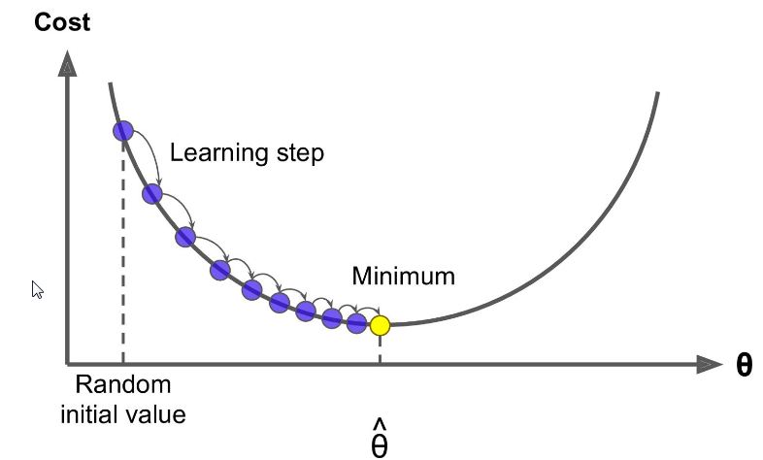
Gradient descent concretly
Start by fillin θ with random values
Improve it gradually by taking one baby step at a time each step attempting to decrease the cost function (MSE here)
Until the algorithm converges to a minimum
An important parameter is the size of the steps
This is determined by the learning rate hyperparameter

Slide 11
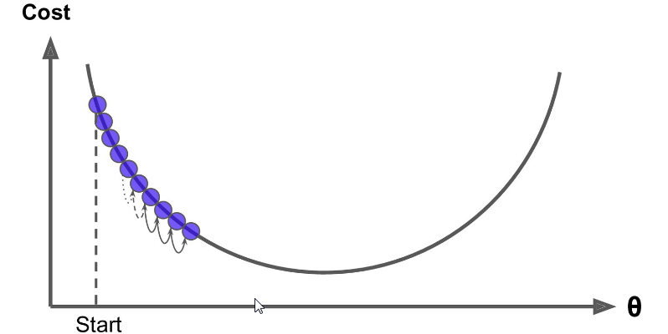
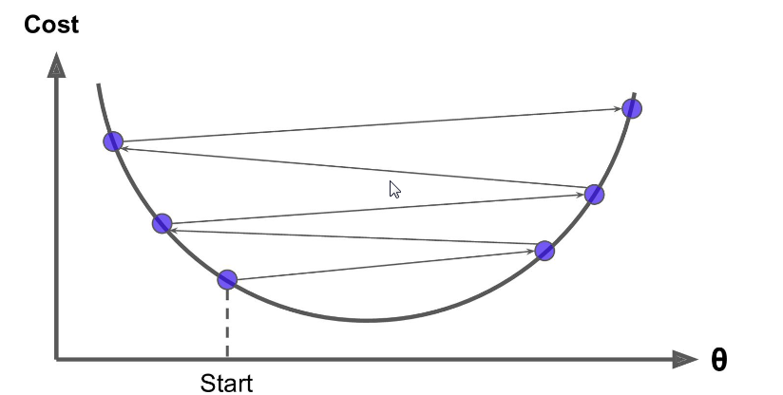
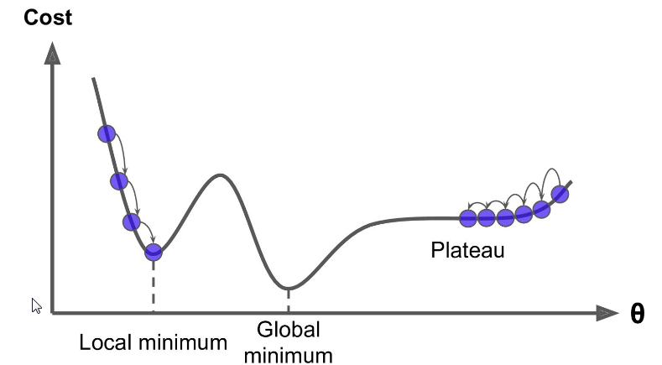
Learning rate
Learning rate two slow
Learning rate two high
Guaranty of convergence only if the cost function is convex
Fortunately the cost function for a linear
regression appear to be convex !
It is also a continuous function

Slide 12
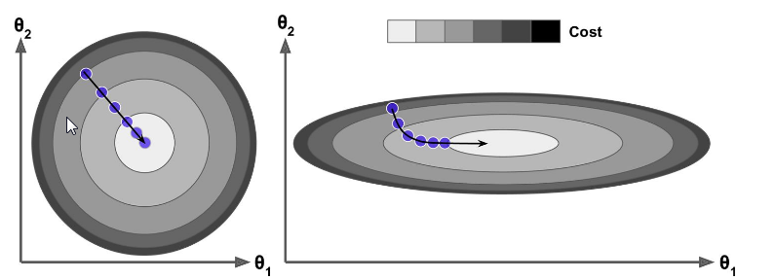
Importance of feature scaling
Warning iIf multiple parameters
Also, the more parameters the longer the search in the parameter space
Fortunatly, the needle is always at the bottom of the valley in aconvex problem

Slide 13
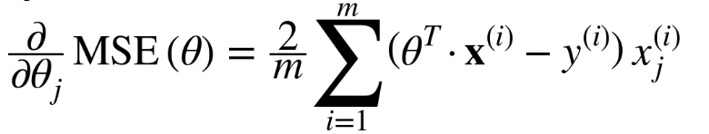
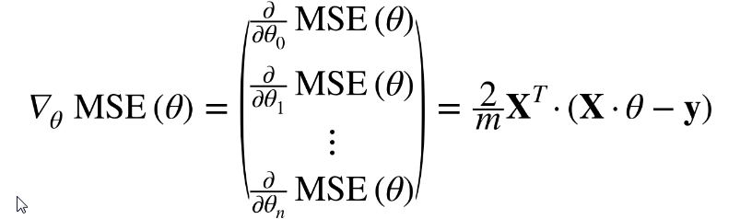
Batch gradient descent
Instead of computing each individual partial derivative
We compute all the derivative in a go
The algorithm involves the full training set X at each Gradient descent step hence the name Batch Gradient descent

Slide 14
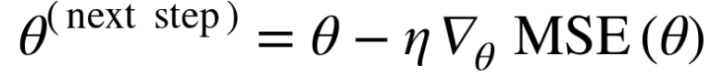
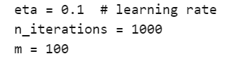
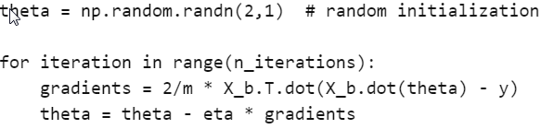
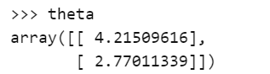
Gradient descent in action
Where η is the learning rate
To compare to the exact solution

Slide 15
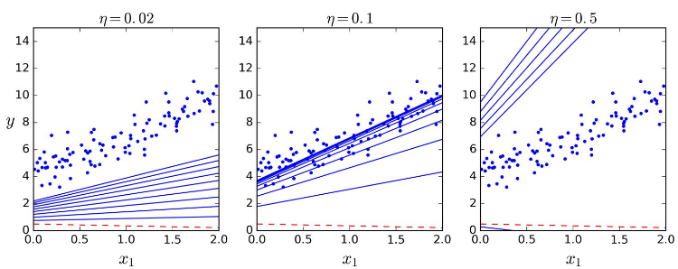
Learning rate in action
To find a good learning rate, you can use a grid search
You can also eliminate models that take too long to converge
Set a very large number of iterations but interrupt when the gradien vector becomes tiny

Slide 16
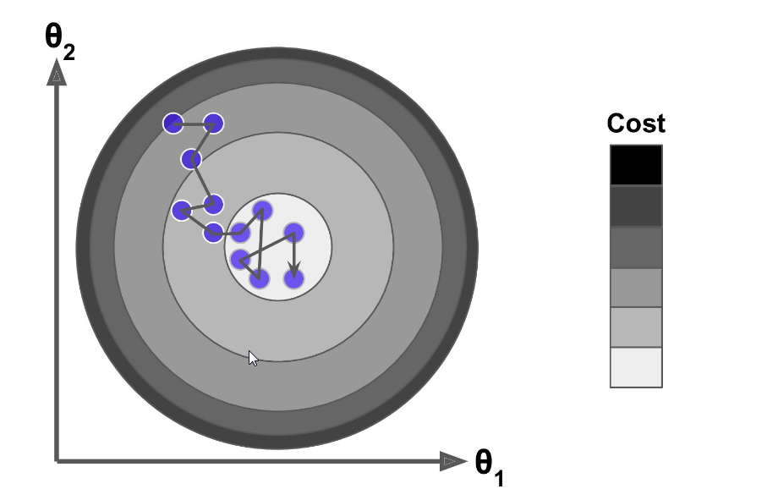
Stochastic Gradient Descent
The main problem with Batch Gradient Descent : it uses the whole training set at every step… it is thus very slow
Stochatic Gradient Descent picks random instance in the training set at every step and computes the gradient based only on that single instance
Much faster but less regular… The final value are suboptimal
Randomness is also good to jump above local minima : simulated anealing
Not a fixed learning rate but a learning schedule with a progressive decrease of the learning rate

Slide 17
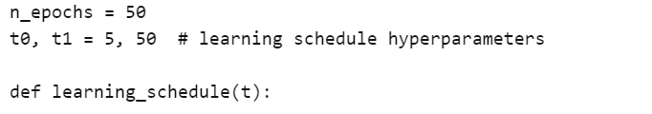
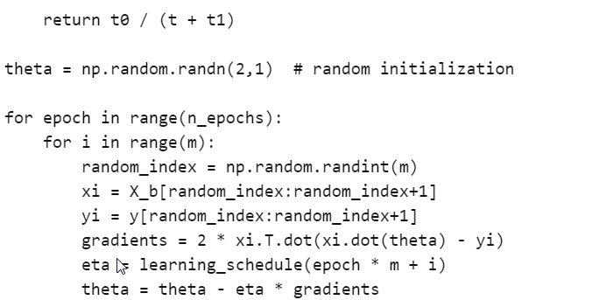
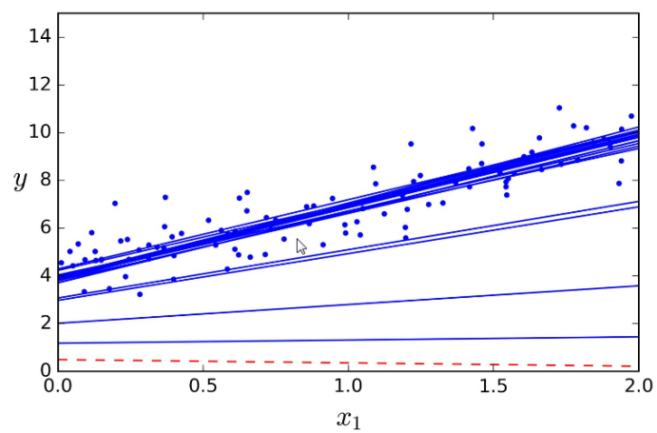
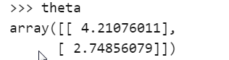
Stochastic Gradient Descent in action
To compare to the exact solution

Slide 18
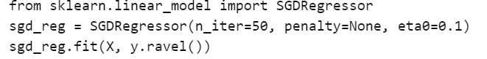
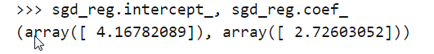
SGD in Scikit learn
To compare to the exact solution

Slide 19
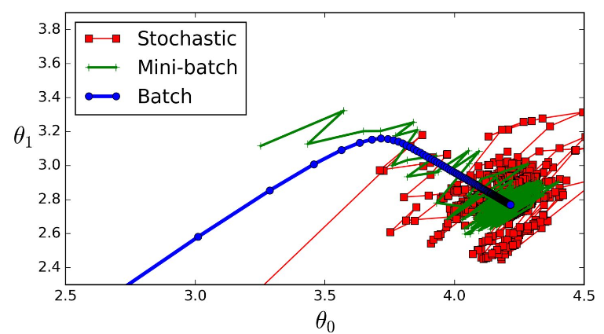
Mini-Batch Gradient Descent

Slide 20
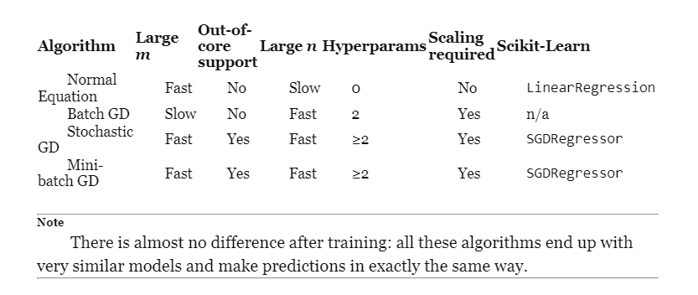
Take home message

Slide 21
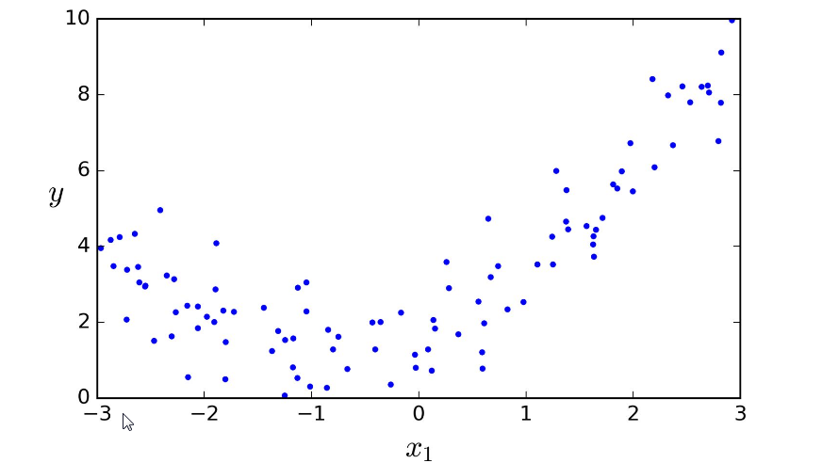
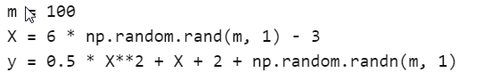
Polynomial regression
What if your data is actually more complex than a straight line ?
Surprisingly you can actually use a linear model to fit non linear data
Add power to each feature as new features
Train a linear odel on this extended set of features
This is called polynomial regression

Slide 22
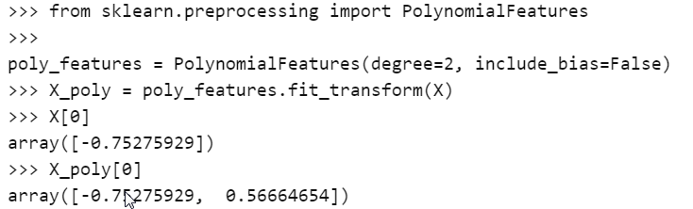
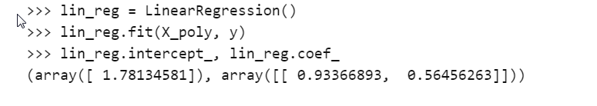
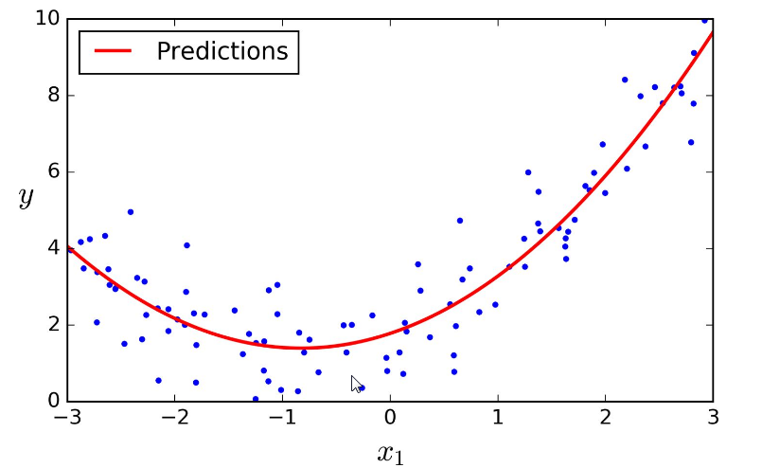
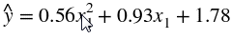
Polynomial regression in action
To compare to

Slide 23
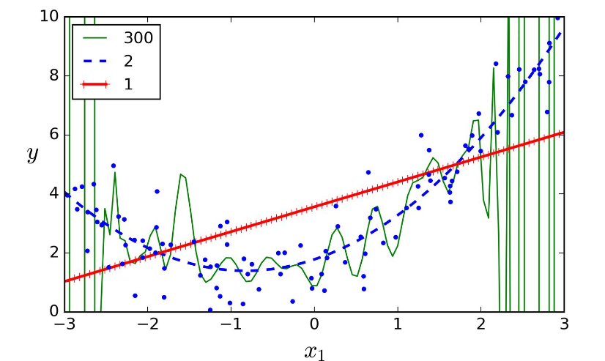
Finding the polynomial dimension
A possible way is cross-validation
Another possible way is learning curve

Slide 24
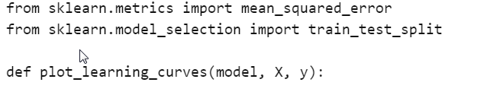
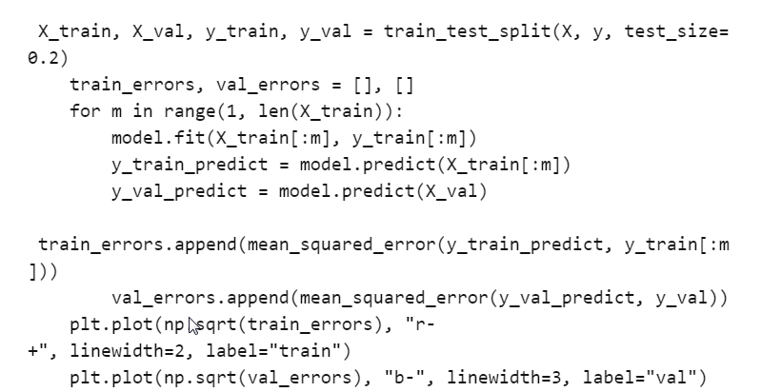
Learning curve
Plot the performance on the training set and the validation set as a function of the training set size (or the training iteration). In scikit learn :

Slide 25
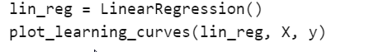
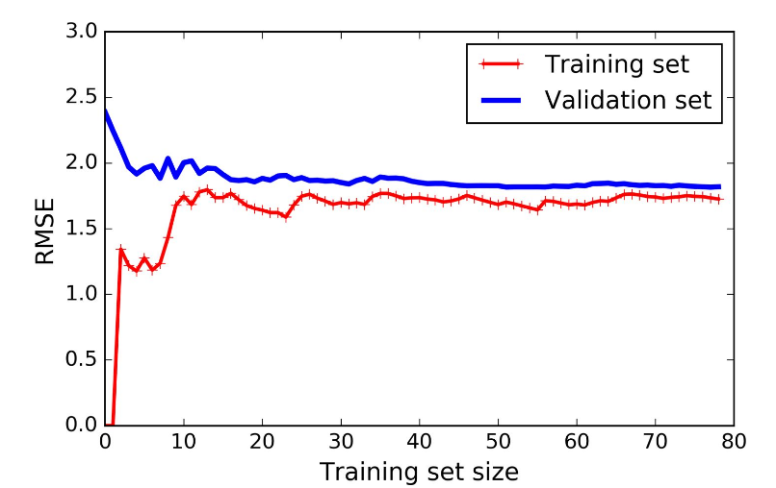
Learning curve in action
At the beginning :
the training set is very small : erro zero
The validation is bad
Then :
Complexity of the data increase and the RMSE is increasing but reaches a plateau
The validation RMSE decreases and reaches a plateau
Both curves are close but fairly high
Typical of an underfitting model
You need a more complex model

Slide 26
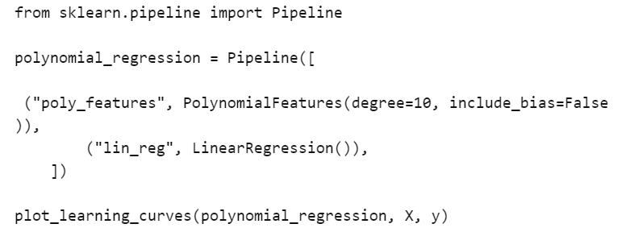
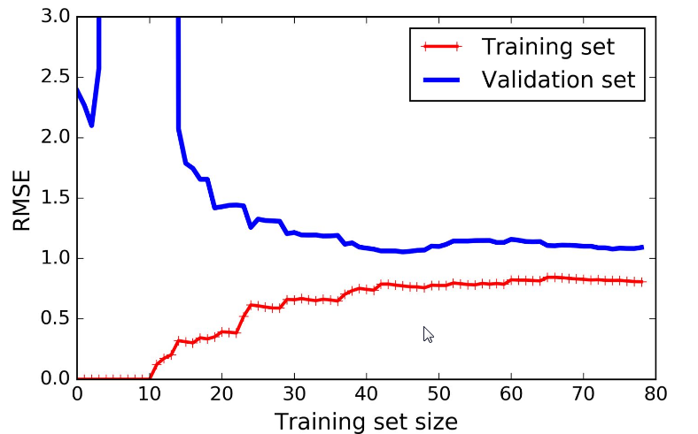
Overfitting
Error is much lower than with linear regression model
There is a gap between the curves
A typical signature of an overfitting model
You need more data

Slide 27
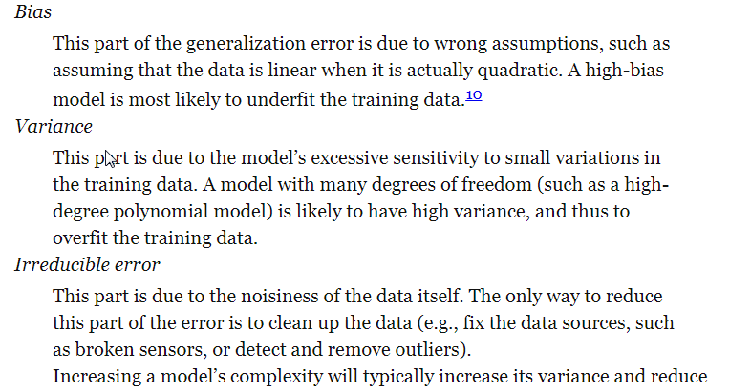
Bias Variance tradeoff

Slide 28
Regularized linear model
Constraints the model not only to fit the data but also to respect some priori
We will study three types of constraints : Tikhonov, Lasso and Elastic Net

Slide 29
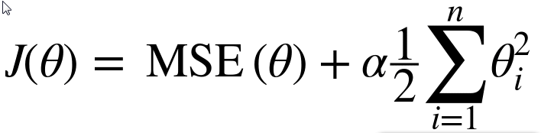
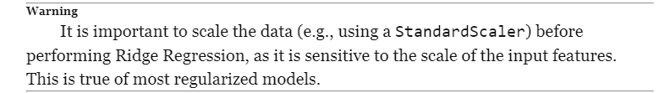
Tikhonov regularization
The second term forces the model to keep weights as small as possible
Alpha is an hyperparameter which controls how much you want to regularize your model
The regularization terms shoul only be added to the cost function during training.
Once the model is trained, you want to evaluate the model’s performance using the unregularized performance measure.

Slide 30
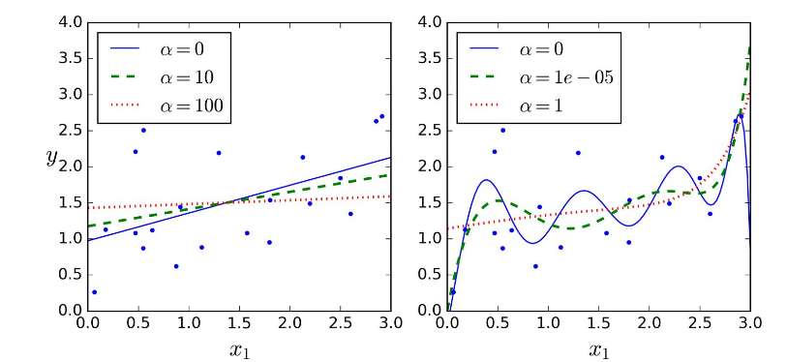
Tikhonov in action
Linear Model
Polynomial of order 10

Slide 31
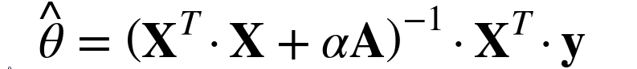
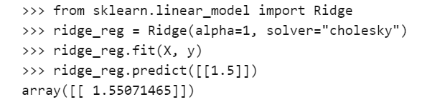

Tikhonov in action
A closed-form analytical expression is possible for batch gradient descent
Or under the form of Stochastic gradient descent

Slide 32


Lasso regularization
Lasso regression tends to completly eliminate weights of the least important features
The lasso cost function is not differentiable at θi=0 but Gradient descent still works fine if you use a subgradient vector when θi=0 .

Slide 33

Lasso in action

Slide 34

Lasso versus Tikhonov

Slide 35


Elastic Net Regularization
A middle ground between Tikhoniv and Lasso

Slide 36

Early stopping
A very different way to regularize iterative learning is to stop training as soon as the validation error reaches a minimum
As the epoch s bo by, the algorithml learns and its prediction error on the training goes down
After a while the validation erro stop decreasing and starts to go back up
This indicates that the model has started to overfit the training data

Slide 37


Early stopping in action

Slide 38



Logistic Regression
Computes a weighted sum of the input features
but instead of outputting the result directly like a linear regression model does
it output the logistic of the result

Slide 39

Training and cost function
For training the parameter vector θ is to be set so that the model estimates high probabilities for positive instances (y=1) and low probabilities for negative instances (y=0)
-log(t) grows very large when t approaches 0, so the cost will be large of if the model estimates a probability close to 0 for a positive instance and it will also be very large if the model estimate a probabilito close to 1 for a negative instance
-log(t) is close to 0 when t is close to 1 : so the cost wil be close to 0 if the estimated probability is close to 0 for a negative instance or close to 1 for a positive instance

Slide 40


The cost function over the whole training set is simply the average cost over all training instance.
It can be written in a single expression called the log loss
The bad news is that there is no known closed-form equation to compute the value of θ
But the good news is that this function is convex so that Gradient Descent (or any other optimization algorithm) is guaranteed to find the global minimum

Slide 41

Logistic regression in action

Slide 42



Decision Boundaries

Slide 43

Classification results

Slide 44


Softmax regression
The logistic regression model can be generalized to support multiple classes directly without having to train and combine multiple binary classifier
Given an instance X, the Softmax regression model first computes a score sk(x) for each class k, then estimates the probability pk of each class by applying the softmax function
where K is the number of classes, s(x) a vector containing the scores of each class for the instance x

Slide 45


Softmax training
The cost function used is often the Cross-entropy
Cross-entropy gradient

Slide 46

Softmax in action

Slide 47
Next course
Support vector machine (SVM)
David Rousseau

